Slide 1


Alpha Phi Omega
Chi Chapter at UCLA
Alpha Mu / Kay Krenek Term, Meeting 2
October 22, 2014
www.apo-x.org

Slide 2
Agenda
1. Michelle Balatbat’s Presentation
2. Officer Updates and Announcements
3. Chapter Business
4. Finance VP Special Elections
5. Keurig Presentation
6. Last Announcements

Slide 3

Michelle Balatbat
SERVICE TO OUR CAMPUS!
APO Brother from UC Merced/Alpha Eta Gamma Chapter
Running for a USAC position: Transfer Student Representative
Qualifications:
Co-Chair of Student Transfer Alliance
Exec Director of IVP Student Group Outreach
Transfer Student Group Liaison
Vote on myUCLA by Thursday!

Slide 4
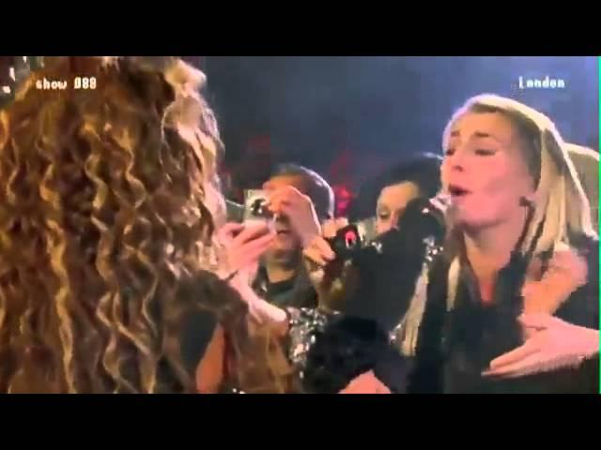

Slide 5
President
Raymond Mai
president@apo-x.org
Executive Committee
excomm@apo-x.org

Slide 6
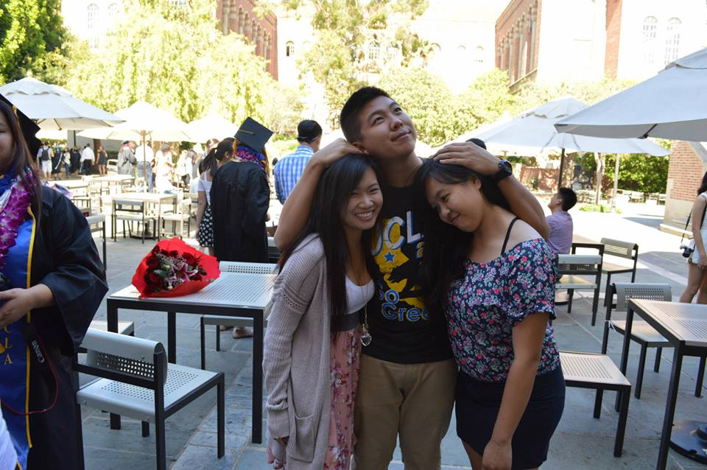
What separates us from other service orgs?
BROTHERHOOD.
Take the next 15 seconds to compliment the person next to you.

Slide 7

Mental Health Awareness
Contacted the “All of Us” UCLA Mental Health Awareness Campaign team to partner up
Focus on Awareness and Education of Mental Health this term
Stat: Over 50% of college students graduate dealing with a mental health issue, including social anxiety and depression.

Slide 8

Career Development
On-Campus Jobs Fair put on by FSC
October 27th, 2014 from 11am-1pm at Kerckhoff Grand Salon

Slide 9
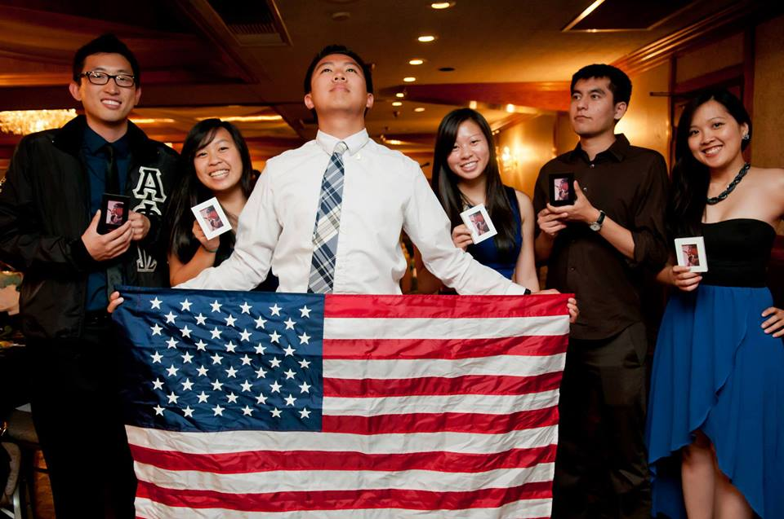
Open Communication
As always, if you feel that there can be improvement in any or all aspects of Excomm, do not hesitate to contact me. I will keep all comments strictly confidential.
Like I say every week, “We are here to serve YOU”
Excomm Meetings: Sundays at 8pm
Email: President@apo-x.org
Phone Number: 619-248-1113

Slide 10
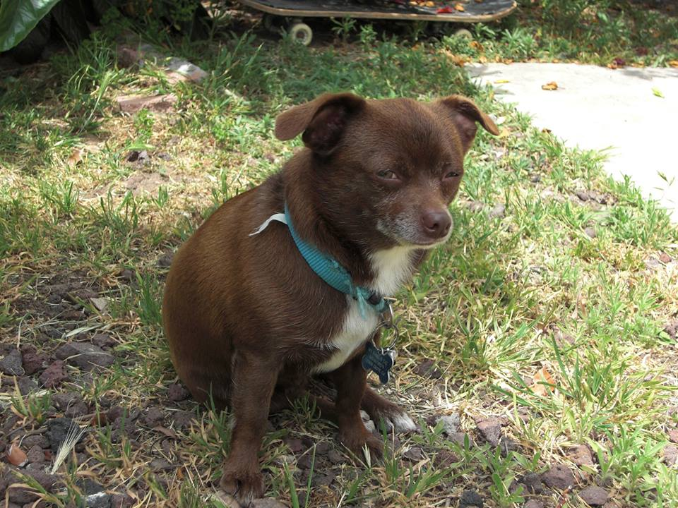
I’M OUTRO, DAWG.

Slide 11
Administrative VPs
Kevin Quizon & Nicola Yip
admin@apo-x.org

Slide 12

Website Update
Website is currently unavailable due to a server upgrade. Contact respective VP’s for upcoming events and sign ups!

Slide 13
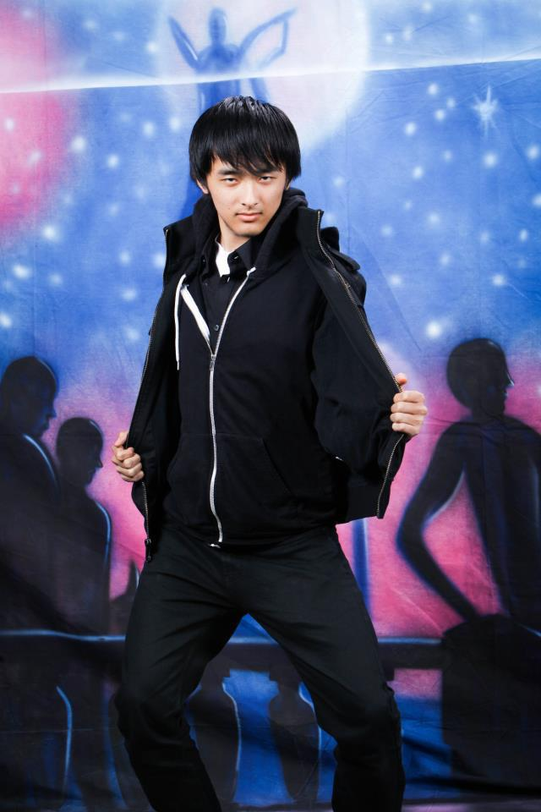
Website Update
Thanks
Joseph!

Slide 14
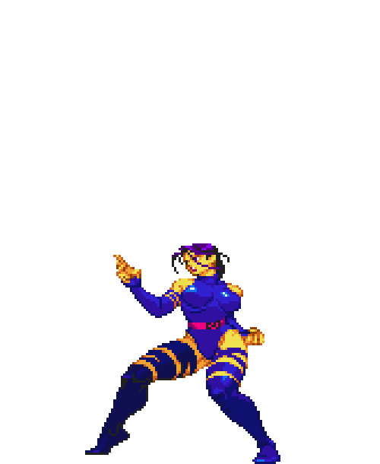
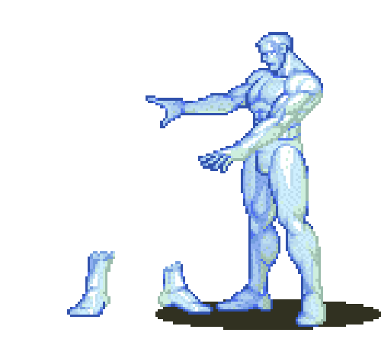

Committees!
DO YOU HAVE A CREATIVE SIDE?
DO YOU LIKE WRITING/TELLING STORIES?
JOIN OUR NEWSLETTER COMMITTEE!!

Slide 15

Alumni Mentorship!
Apps coming out soon!

Slide 16
MEMBERSHIP.
Jeremy Gozzip & Andrew Suh
membership@apo-x.org

Slide 17
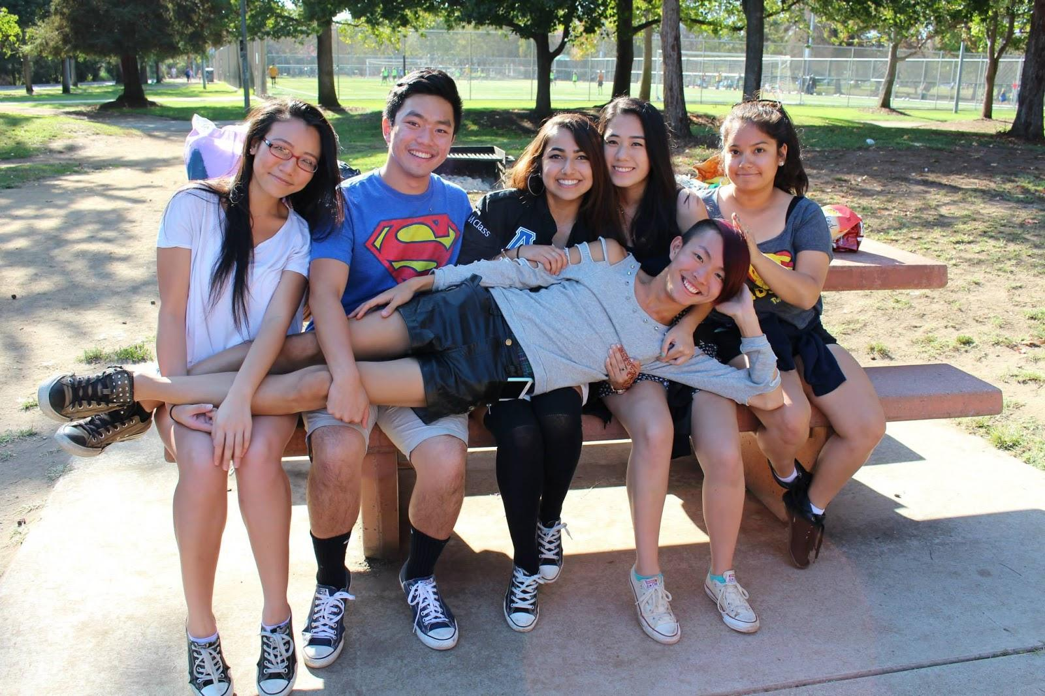
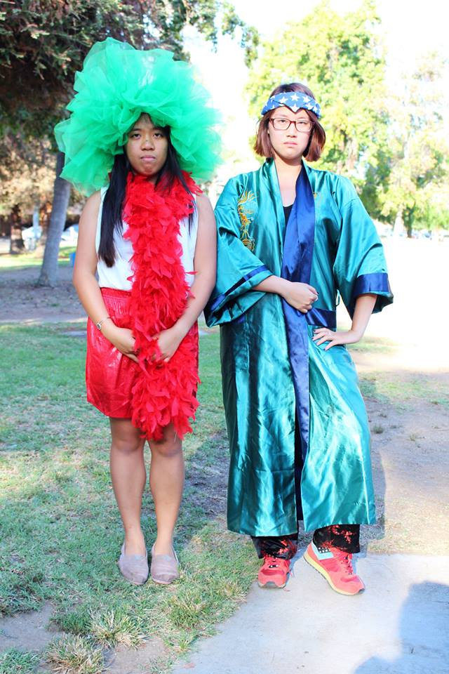
Active Bonding Day
THANK YOU EVERYONE WHO CAME OUT TO ACTIVE
BONDING DAY!

Slide 18
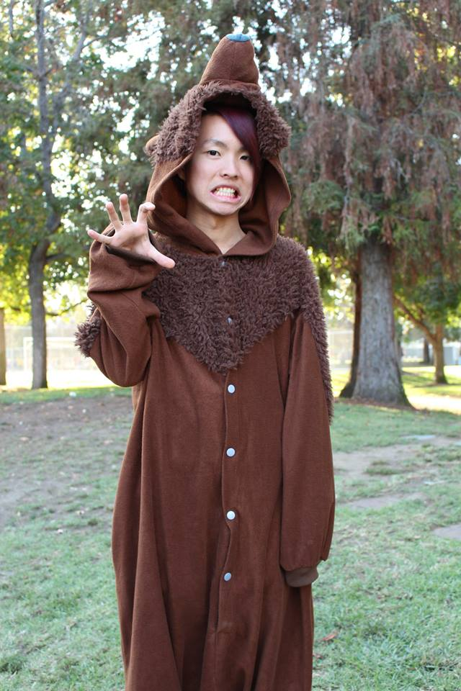
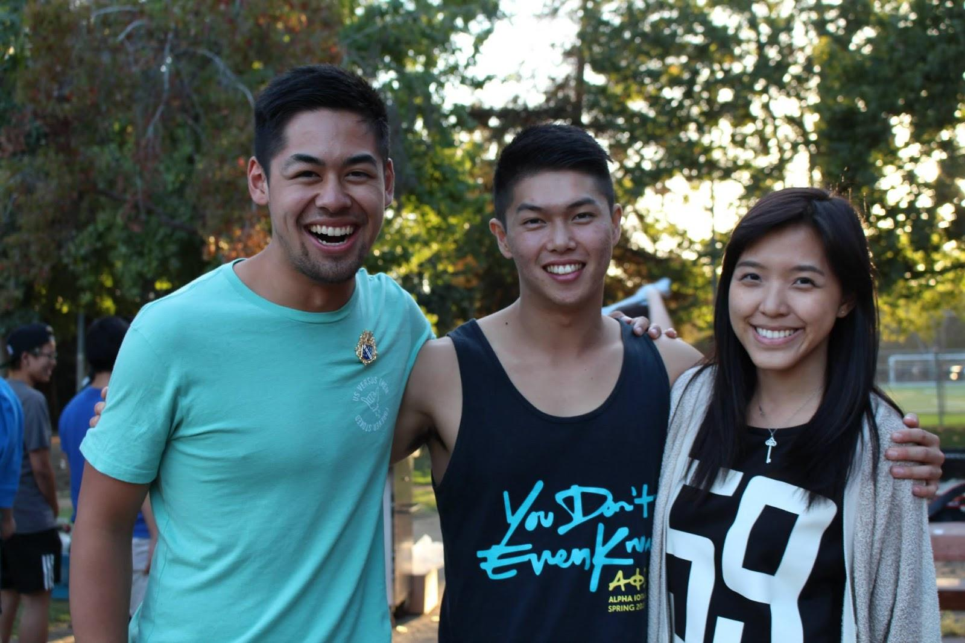
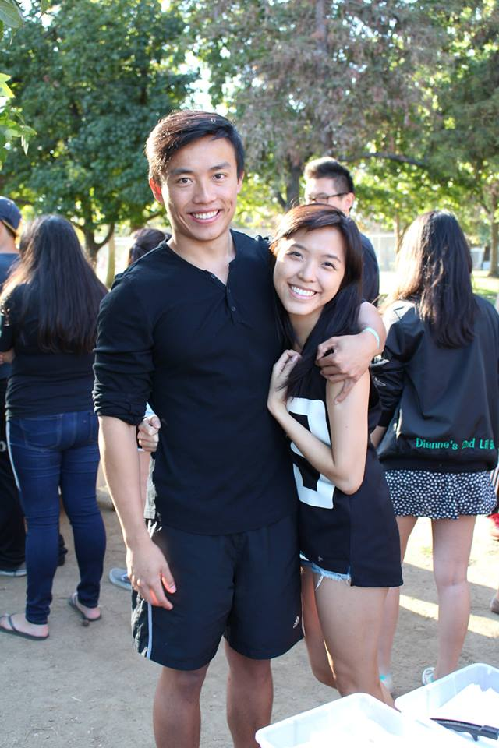
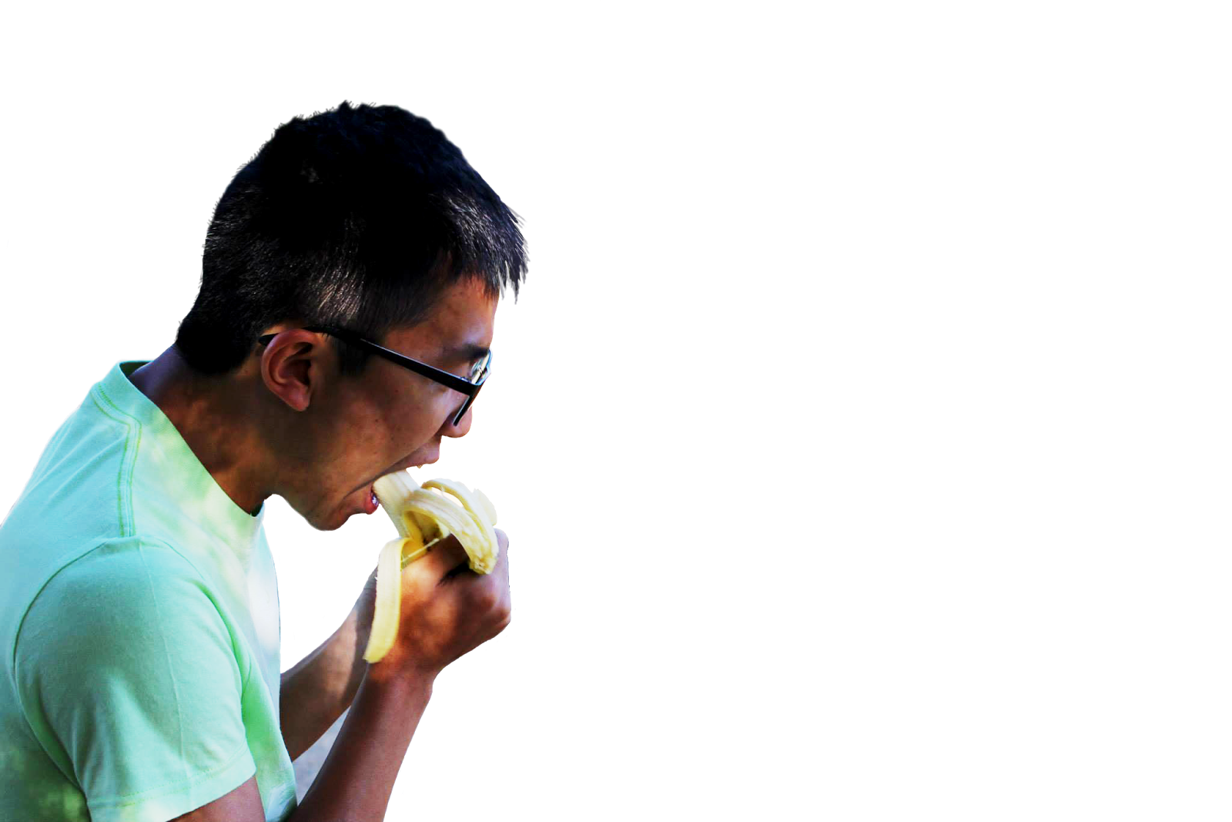
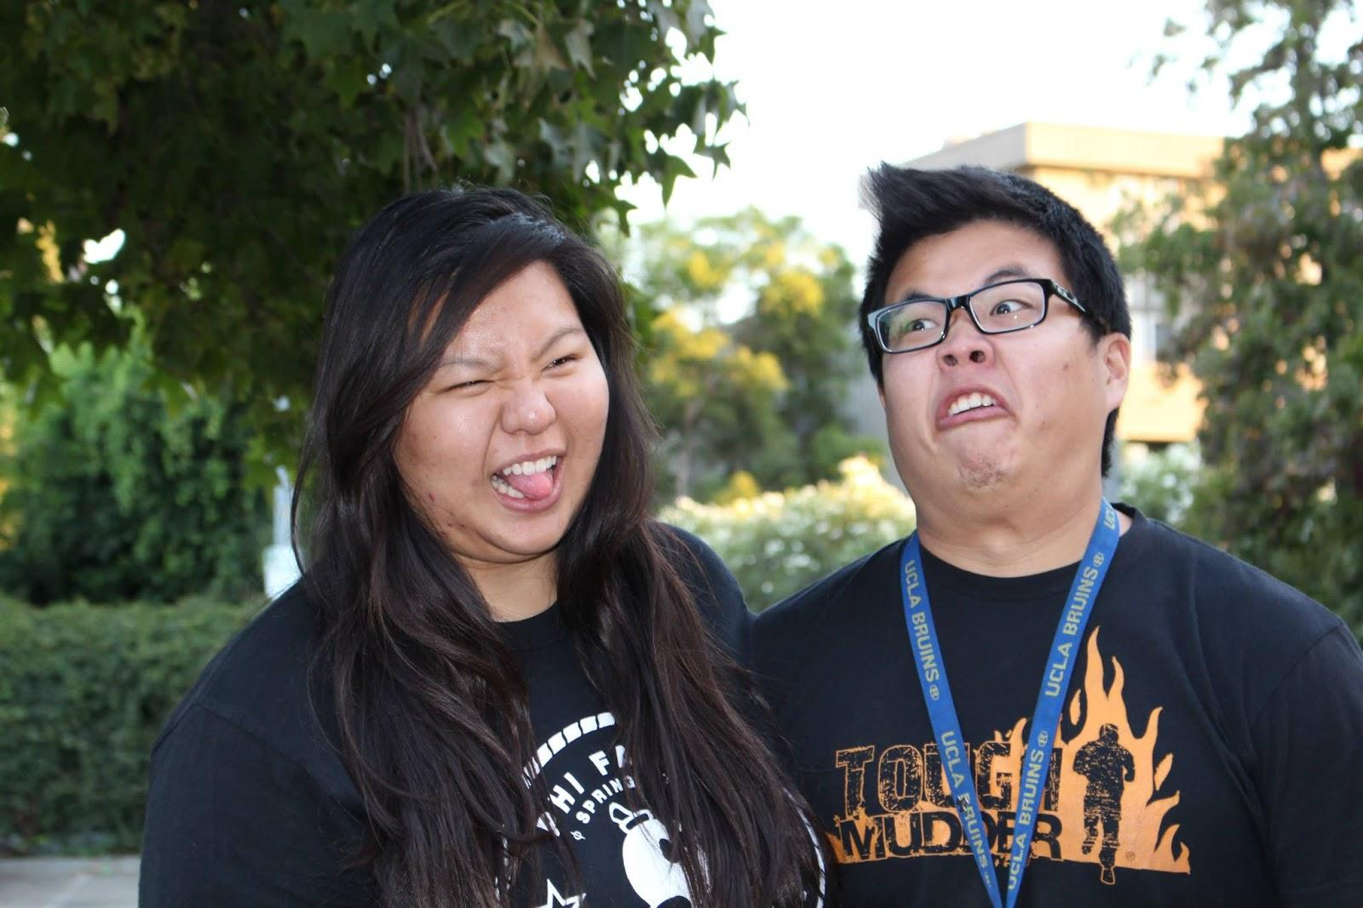

Slide 19

Contracts + Dues
*REMINDER :
ACTIVE CONTRACTS AND DUES ARE DUE by CM3
IF YOU’VE ALREADY BEEN SELECTED TO BE IN A COMMITTEE, YOU STILL NEED TO FILL ONE OUT
ASSOCIATE CONTRACTS WILL ALSO BE DUE AT
THAT TIME
DUES GO TO JT
CONTRACTS GO TO MVPs
<3

Slide 20

Campout
...IS NEXT WEEKEND!
(OCTOBER 31- November 2).
Actives, this is also a time for you to strengthen your bond with other people in this chapter and also relive your pledging experience.
MVP’s will be facilitating activities for Actives
throughout the day.
Please come out! The more the merrier! :D
Kthxbai~

Slide 21
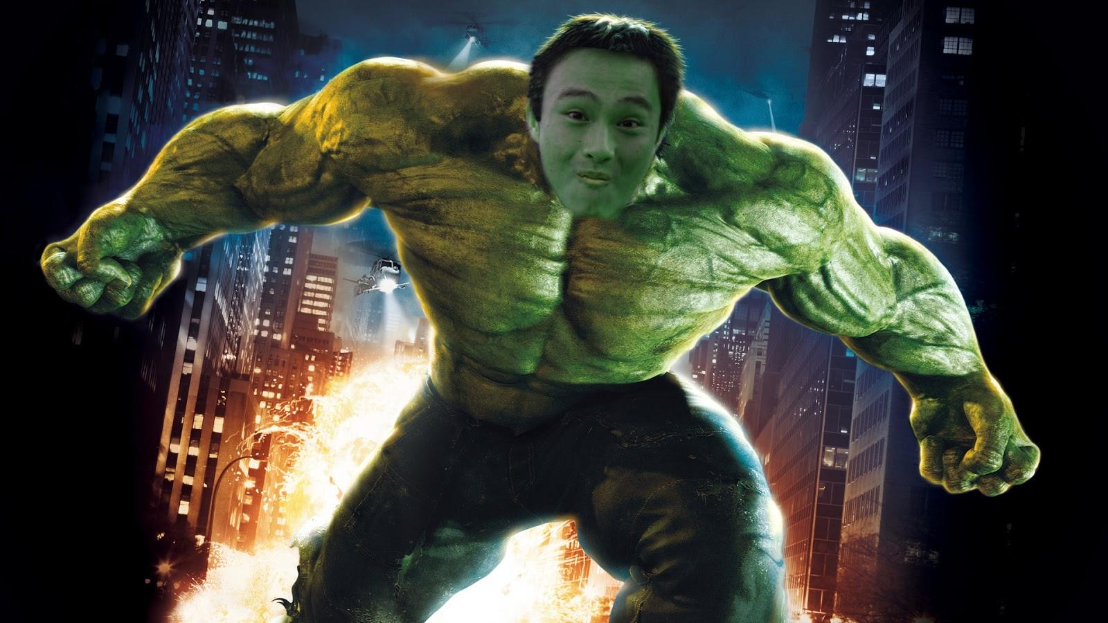
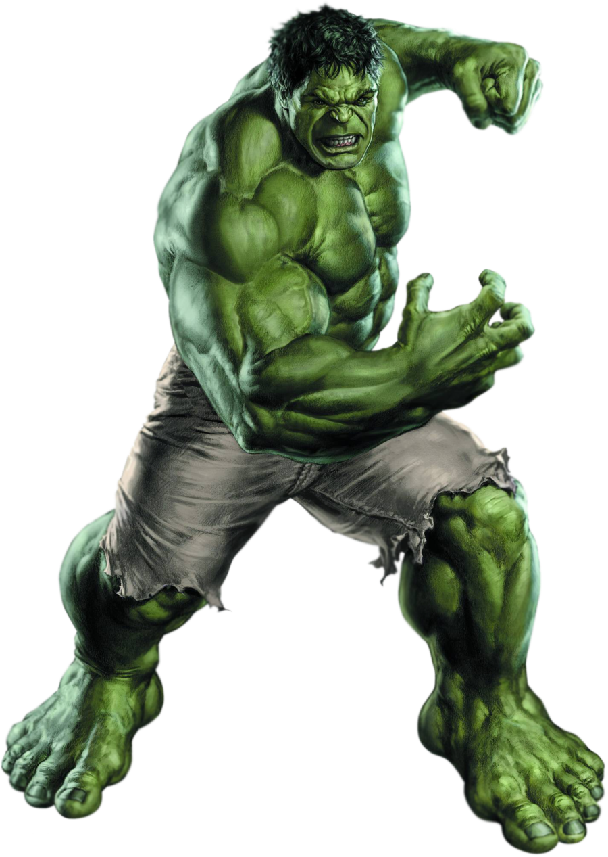
Special Achievement 1:
HULK
Instructions _
Take a photo of members in your family wearing GREEN shirts and working out at the gym.
(4 people, 3 class minimum)
HULK SMASH!

Slide 22
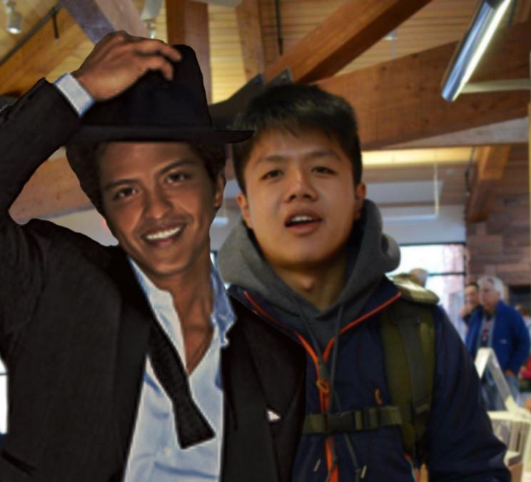
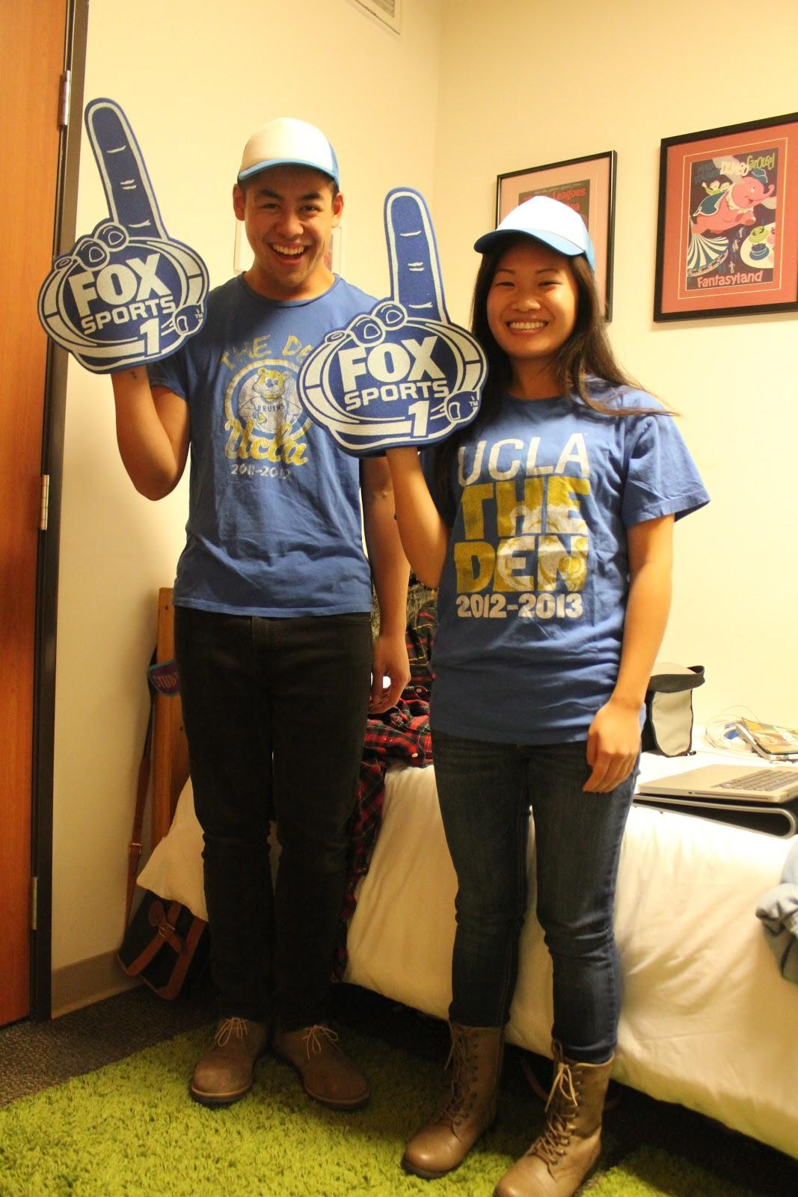
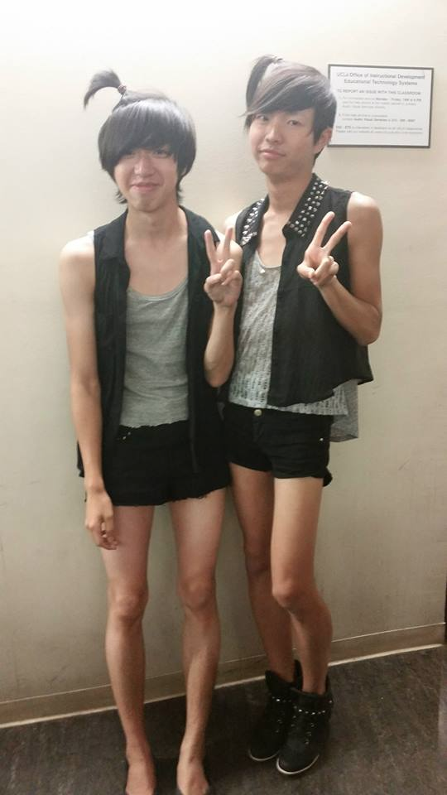
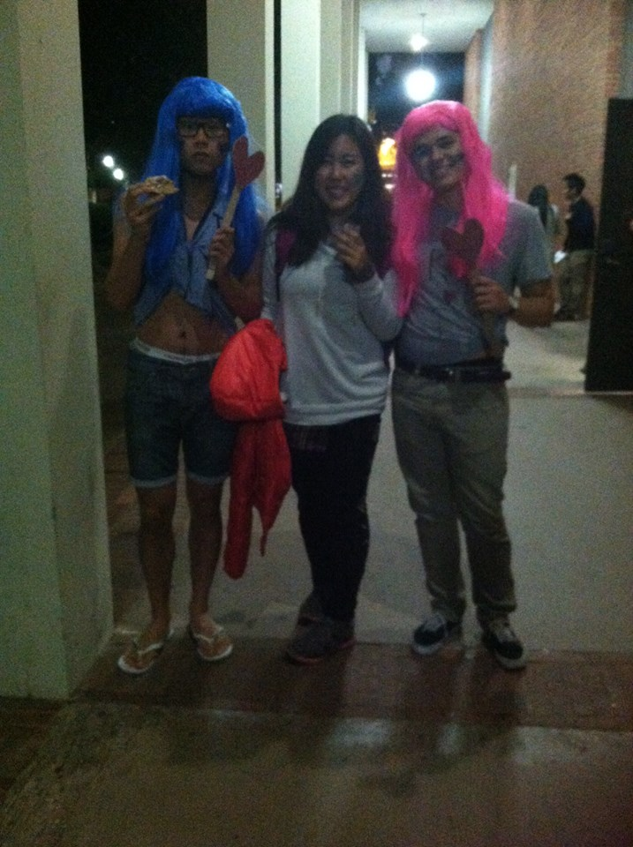
------ NEXT WEEK -------
TWIN DAY!
DRESS UP WITH SOMEBODY TO
LOOK LIKE TWINS.
(We not gonna
count chapter standards.)
examplez -->
DIDN’T MATCH.

Slide 23


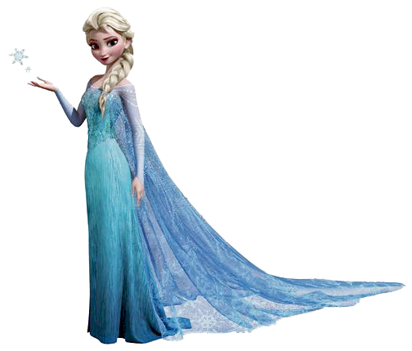
GET READY FOR SKI TRIP y’ALL.
{Details coming soon}

Slide 24
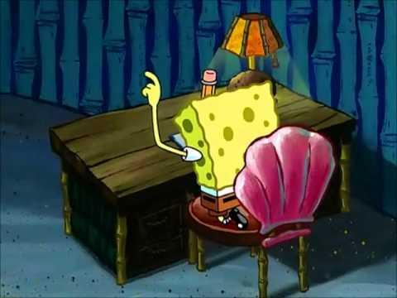
Shoutout Book
It’s comin’ around RIGHT NAO!
The perfect way to recognize your bruhs
who helped you out this past week!
Write a shoutout...or 2...or 10...hehe
TIME TO READ THE ONES FROM THIS PAST WEEK!
OOOOOOH!

Slide 25
Fam Head Introductions!

Slide 26

Game Time
WE NEED 3 MEMBERS FROM EACH FAMILY + PLEDGES.

Slide 27
Service VP
Rui Guo
apoxservice@gmail.com

Slide 28
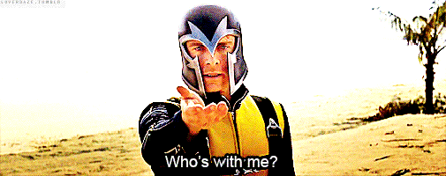
Upcoming Events!
10/24 Friday
Special Olympics SGV
10/25 Saturday
[7H] Enrich LA
[1H] Tour UCLA
[XH] Color Run - CLOSED!
Monday Night Mission and Meals on Wheels every weekday!

Slide 29
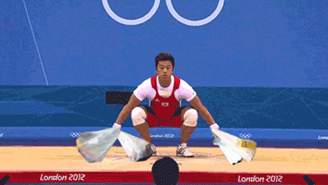
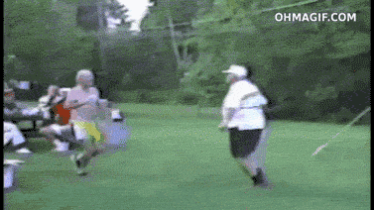
Suggestions?
If anyone has service projects they want to attend, message me!

Slide 30
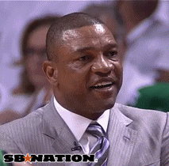
Bracelets Update
15 people cap
If there are over 15 people who complete the requirement, it will be determined by the number of hours completed
If there are ties, it will be determined by who completes the requirement first
Do it for the service!!

Slide 31

Pledge Parents
Brian Lee & Emily Neai-Proeung
apoxpparents@gmail.com

Slide 32


WELCOME ALPHA MEW!

Slide 33

Assignments
10 actives
PIFs - Going very SWIMMINGLY
Mission: Toast Song 4-Part Harmony
Quiz: Excomm, Toast Song, Mission, Vision

Slide 34

Interviews
Please let us know of any concerns
Like, actually. Come to us first.
Interviews are 2 sided
It’s week 1 yall they’re still learning.
If things come up during an interview, pls tell them yourself so they can fix it on the spot! Actives are educators.
Treat pledges the way that you wished actives treated you when you were pledging.

Slide 35

Campout!
2 weeks away!
Oct 31-Nov 2
Please come out
and meet the Pledges :3!
Let us know if you can come/drive up Friday!

Slide 36
Finance VP
Jonathan Liu
finance@apo-x.org

Slide 37
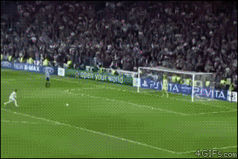
Dues!
Pledges on the PP - $20 by the end of today
Actives - pay dues before end of next Wednesday or you will go bad standing

Slide 38
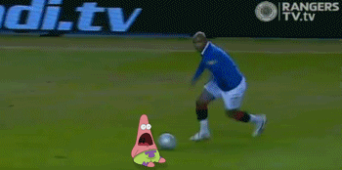
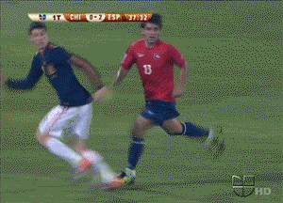
Payment Plan
Need based, not for everyone
We all bear a responsibility to help the Chapter run smoothly

Slide 39
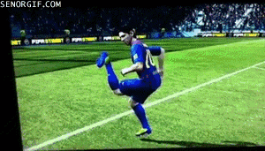
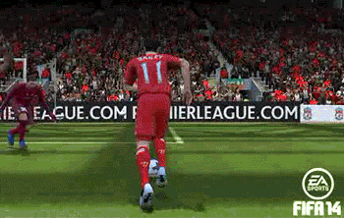
Upcoming fundraisers!
Look out for TV tapings!
Aiming for 1-2 fundraisers a week
Let us know of suggestions!

Slide 40
Fellowship VPs
Ann Dai & Danny Ly
fellowship@apo-x.org

Slide 41

Fellowship events this week!
Tonight!!!!!! Meet the Pledges ( After meeting )
10/23 Thur PUT IN WORK(out) 3p.m.
10/24 Fri Six Flags!! 11a.m.
10/24 Fri It’s Game Time 8p.m.
10/25 Sat Visit The Getty 2p.m.
10/26 Sun Tough Mudder
10/27 Mon Dorm Dinner 6p.m.
How to sign up for chairs?

Slide 42
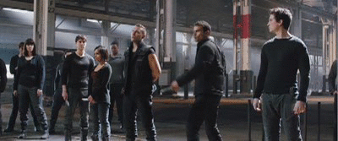
Chivergent Sign up!!
Please sign up on the sheet we pass out
Commitment is toooo long?
What kind of missions??
Don’t have enough people??

Slide 43
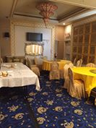
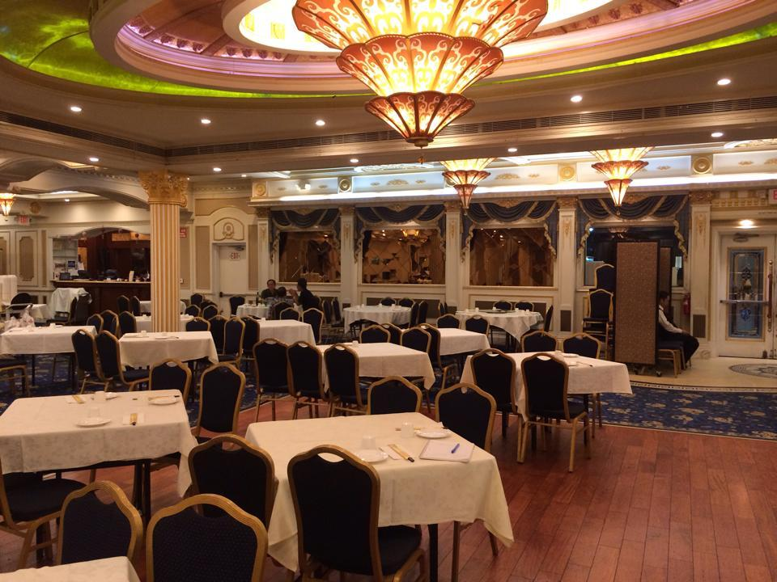
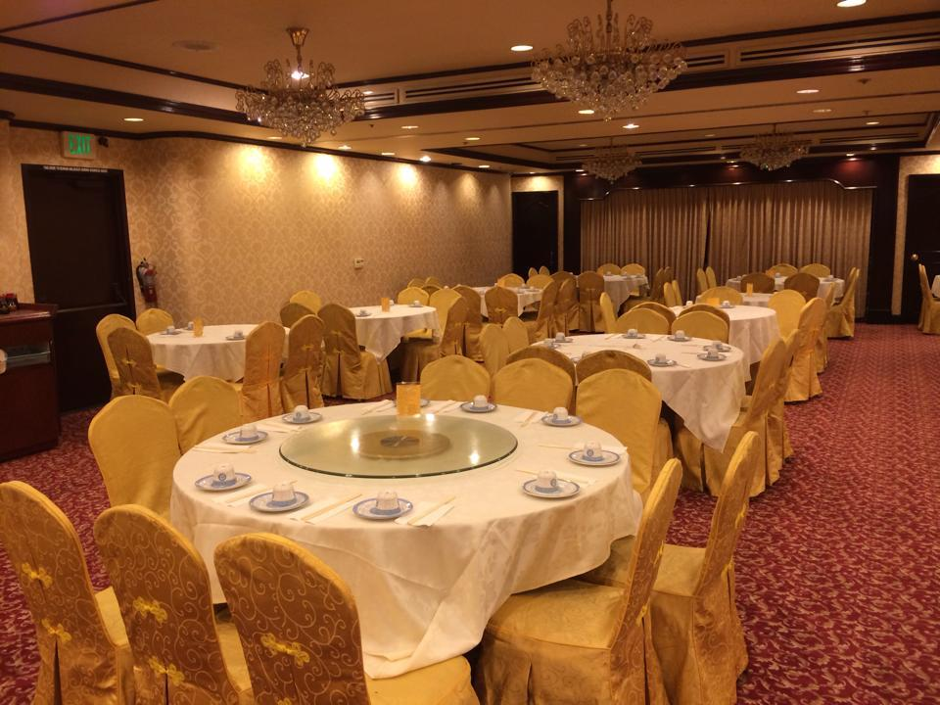
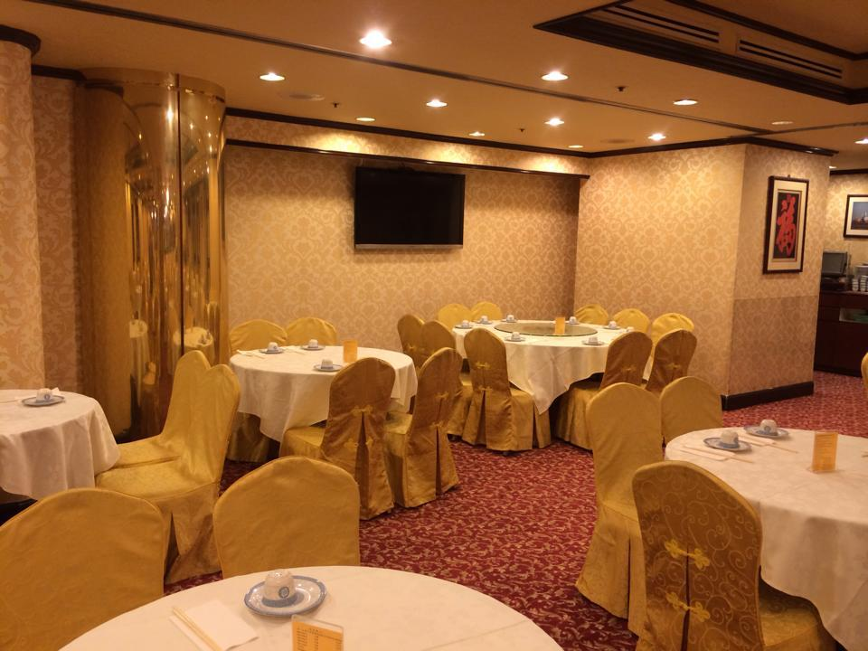
Looking Good Night
Capital Seafood
$25 Chinese Restaurant
Stage, Music, bigger
Express Harbor
$22 Chinese Restaurant
Stage, Photobooth,

Slide 44

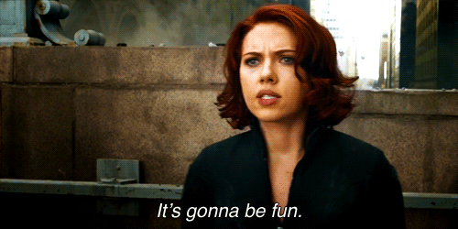
Meet the Pledges
Have more chance to know actives and pledges!
After Meeting. Meet outside of meeting room!
Actives sign in with Danny/ Pledges sign in with Ann
It is only 1 hour event! We will play games together!
Hope everyone can join us!!!

Slide 45
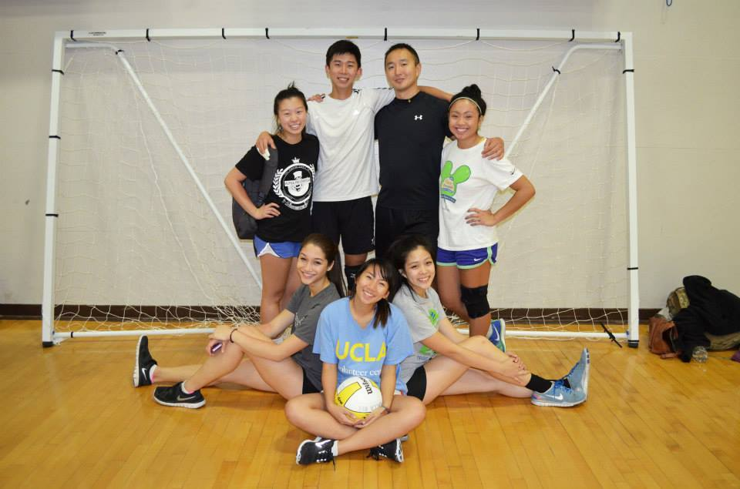
IM Volleyball
We have our first volleyball game tonight!!
10 p.m. Meet at SAC 2nd floor
Come cheer for our wonderful team if you have time!
Our players for tonight:
Tina Ngo, Sheila Wahezi
Linda Nguyen, Ivy Nguyen
Paul Choung, Danny Ly
Ann Dai
If you are also interested!! It’s not late to join us!

Slide 46

Give us some ideas!!
Write down your creative ideas for fellowship events!!!!
It is on the last page of binder we pass around!

Slide 47

Historian
Juana Li
historian@apo-x.org

Slide 48

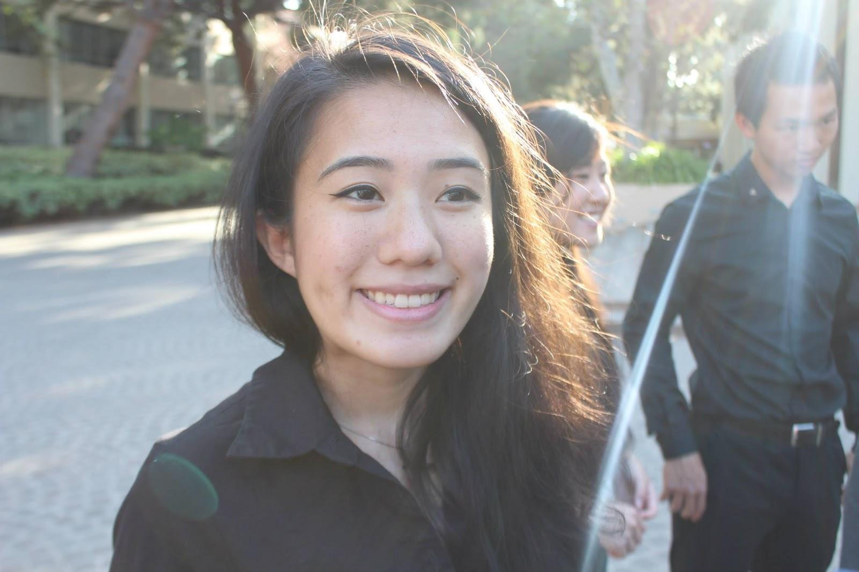
Updates
ACTIVE PICTURE TODAY!!
Stay after meeting if you can for headshots!
More headshots next week!
Continue sending me nominations for brother of the week or Facebook Iris Lam

Slide 49

Join My Committee!
Pictures/Videos (1)
Termbook (1)

Slide 50
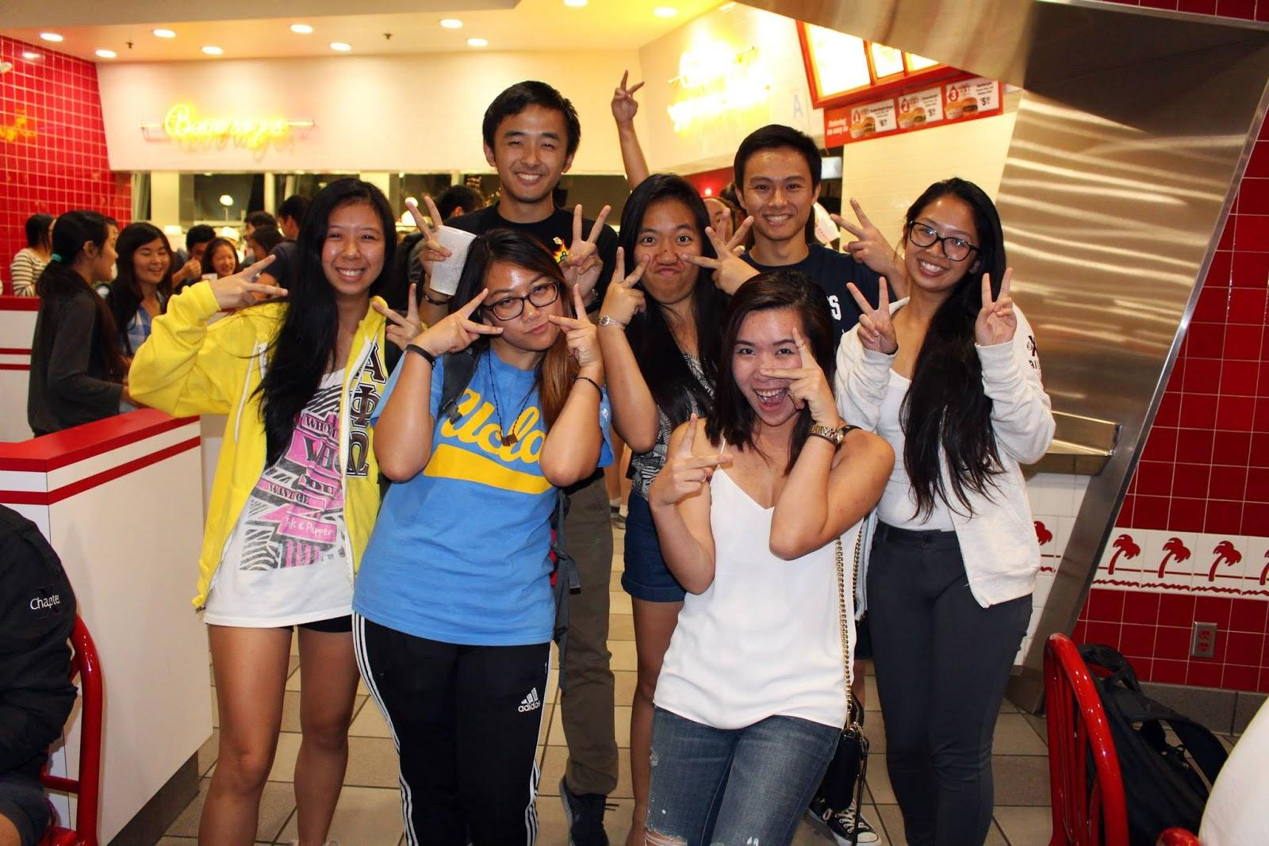
Brother of the Week

Slide 51
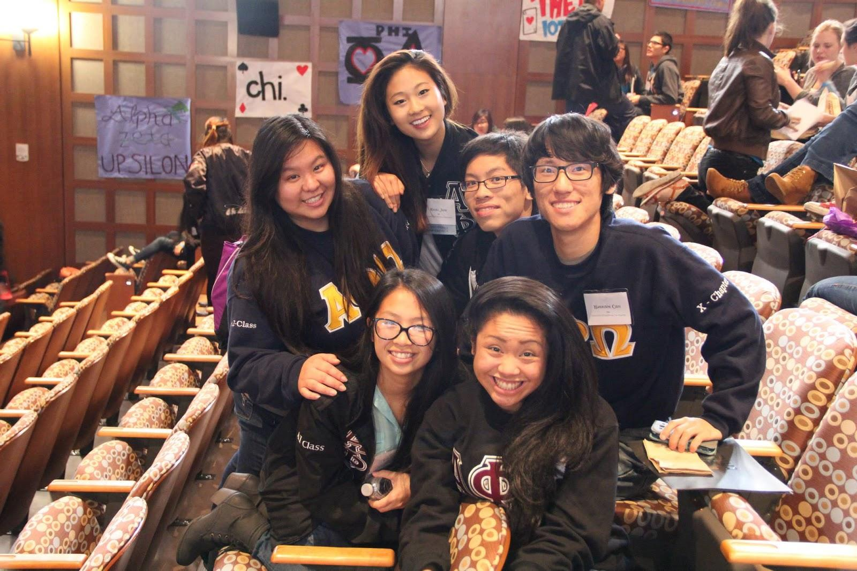
Brother of the Week

Slide 52
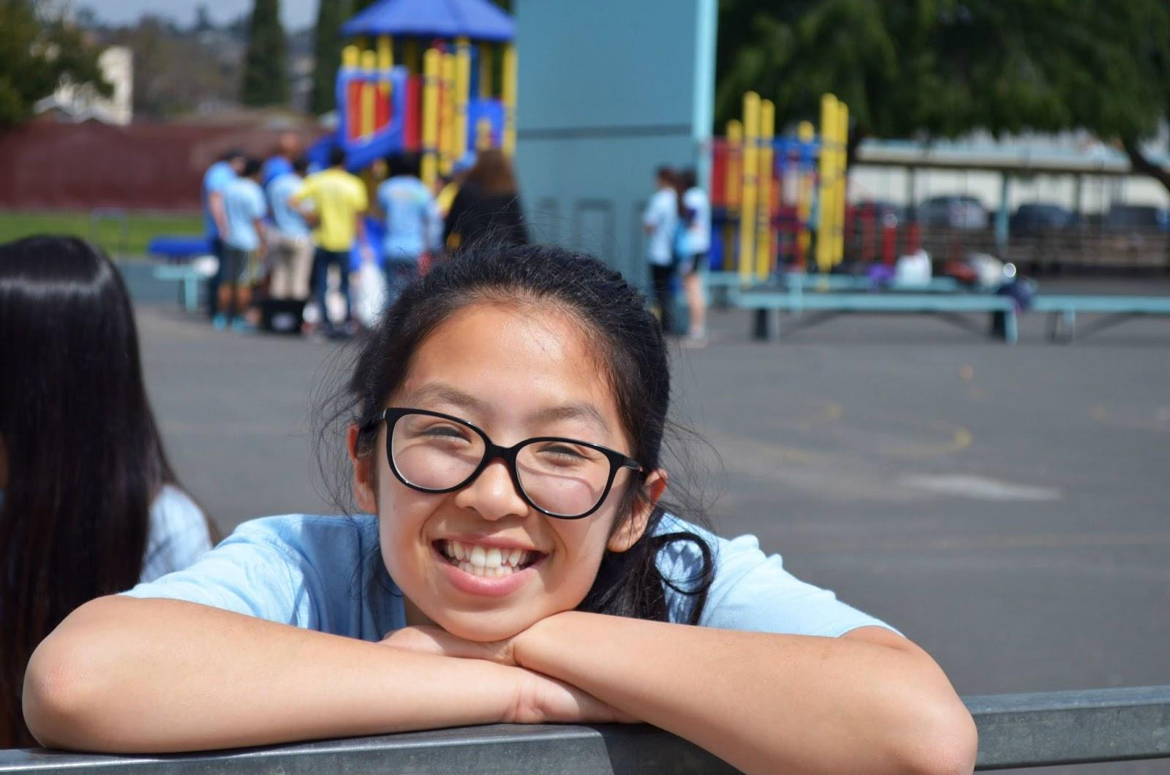
Lisa Lau!

Slide 53

WEBISODE #1
ENJOY GUYZ!
https://www.youtube.com/watch?v=sa9E41NP1JU&list=PLsVaMeiV0N4JeYXoTlagyNuZ2l8Zd3rc_&index=1

Slide 54
Sergeant-at-Arms
Josh Chin
apoxsergeant@gmail.com

Slide 55

TRACKED
ALL CHAIRING, CM Attendance up to this point have been tracked :)

Slide 56
STRIKES
not meant to be a form of punishment
method of learning
keeps everything in order

Slide 57
Card Strikes
you get a strike for causing a disturbance during meeting
yellow = first warning
orange = second warning
red = strike
3 yellow = 1 strike
2 orange = strike

Slide 58
ATTENDANCE
CUT OFF TIME = 7:05PM sharp; or 5 minutes from after the gavel
you MUST have a valid reason for coming late
~ going to a different organization’s meeting does not count as excuse
~ studying is not an excuse; if you want to leave early to study, DON’T come to meeting

Slide 59
ATTENDANCE
if you do arrive late, you CAN NOT leave early
CUT OFF TIME FOR COMING LATE = 8:00PM sharp ~ anytime after, just don’t show up, you’re not getting credit

Slide 60
ATTENDANCE (STRIKES
If you come after 7:05pm but BEFORE 7:30pm it will be a strike.
Coming AFTER 7:30pm it will be a strike AND no meeting credit.
~ so please arrive on time

Slide 61
CHAIRING RESPONSIBILITY
send reminder email at least ONE day (morning of) before event ~ 8:00AM sharp
CALL ALL attendees one day prior to event date
Submit Evaluation Form on Website: due in ONE WEEK from start of event date
SEND PICTURES TO HISTORIAN

Slide 62
CHAIRING RESPONSIBILITY
Reminder Email: [Category] Name of Event
leave date/time in reminder email message

Slide 63
WEBSITE ALTERNATIVE
If you want your name removed from the event itself, contact me via FACEBOOk PLEASEEEEEE :) ~ leave date and name of event as well as what category (leadership, fellowship, etc.)

Slide 64
CONTACT ME
via FACEBOOK MESSAGE ~ for anything like late to meeting, lost pin, etc.
EMAILS ~ for reminder emails ONLY

Slide 65
Interchapter Chair
Chanel Ng
interchapter@apo-x.org

Slide 66

Show some love...
WITH IC BRACELETS!
The order has been put in! Expect them soon for your upcoming IC events

Slide 67
Upcoming IC Events
Ice Blocking x Queen Mary Dark Harbor -- Sunday, Oct 26, 2014, 6:30 PM - 10:00 PM
Alpha Delta's Pumpking Carving -- Thursday, Oct 30th, 7 PM - 9 PM
RHO GAMMA BBQ x MUSIC JAM Saturday, Nov 1, 12:00 PM - 4:30 PM

Slide 68
Upcoming IC Events
Alpha Kappa Souplantation Fundraiser -- Thursday, Nov 6, 6-9PM
Rho Rho Downtown Disney Scavenger Hunt -- Friday, Nov 7, 7PM
Roscoe’s with Alpha Kappa -- Friday, Nov 14, 7pm
Rho Gamma's First Powder Puff Game Friday, Nov 21, 2:30 PM - 5:30 PM

Slide 69
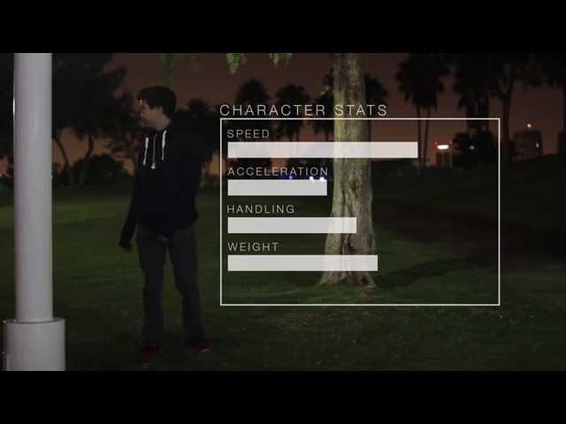
Rho Gamma ICe Blocking

Slide 70

Let me know...
IC fellowship suggestions~
If there’s any particular chapter you want to visit :)

Slide 71
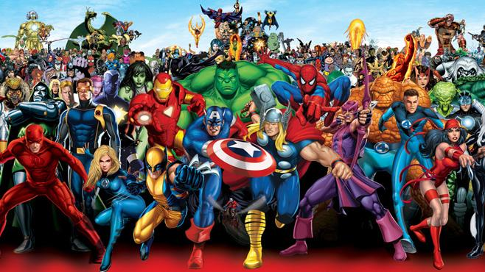
CAC
Paul Choung
cac@apo-x.org

Slide 72
Committee
Ass. CAC Tristan Darvin
asscac@apo-x.org
You may choose to interview Tristan instead of me.
ACS acs@apo-x.org
Abram Summers - chair
Michael Hung
Josh Chang
Hazel Jeon
Irene Tang

Slide 73
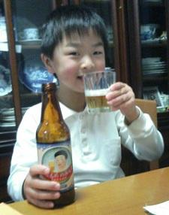
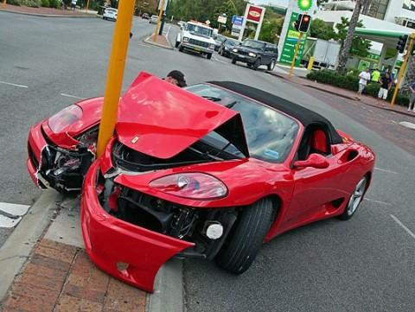
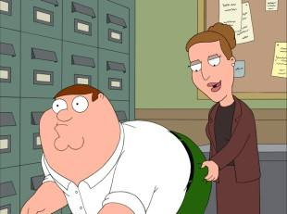
the big picture (s)

Slide 74
Challenge, accepted.
be the first to take a silly/awesome picture with any of the other advisors
chat and learn something interesting about them that I don’t already know
post both to the APO at UCLA facebook page
Do this and earn a prize. One max per member. One chance per advisor.
Brandy Au, Herumi Ann Baylon, Chan Chan, Maggie Chan, Cindy Chang, Christina Chen, Christina Chin, Yuna Choi, Tristan Darvin, Hieu Do, Linda Ghov, Gordon Huang, Rich Jhong, Bryan Lam, Anna Lee, Frank Lee, Kevin Lee, Eddie Leung, Tiffany Lin, Victor Louie, Tawny Luong, Melinda Ly, Andrew Ma, Ngin Lam Ong, Priya Patel, Jessica Suhardjo, Hande Tan, Nina Tang, Tenmi Tchou, Terry Tiu, Betty Tran, Oakley Trinh, Jeff Tsair, Helen Van, Lynn Vo, Derek Wada, Henry Wang, Jason Wang, Steve Wang

Slide 75
SPECIAL ELECTIONS
Process:
3 Minute Presentation
5 Q&As
Speakers for Candidates
Repeat
Vote
FINANCE VP Candidates
Jonathan Liu & San Li

